Slide 1
Data EXPLORATION

Slide 2
PLOTTING OR QUERYING
Defining new columns
Data subsetting
Ploting
Querying - like tapply, subsets etc

Slide 3
New columns
CAT -> CAT (remember pass/fail?)
NUM -> CAT (intervals)

Slide 4
CUT: Numerical Domain Transformations
score0 <- cut(moody$SCORE,5)
score0
score1 <- cut(moody$SCORE,pretty(moody$SCORE,5))
score1
score2<- cut(moody$SCORE,pretty(moody$SCORE,5),labels=c("very low","low","medium","high","very high"))

Slide 5
MORE TRANSFORMATIONS with CUT
score3 <- cut(moody$SCORE,quantile(moody$SCORE,(0:4)/4))
score3
score4 <- cut(moody$SCORE,breaks=c(0,25,70,100))
score4
score5<-cut(moody$SCORE,breaks=c(0,25,70,100),labels=c("low","medium","high"))
score5

Slide 6
PLOTING NEW COLUMNS
moody$new <- score5
moody$new
ranges<-table(moody$new)
ranges
barplot(ranges)

Slide 7
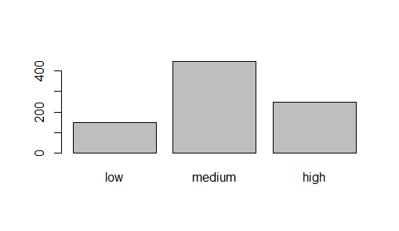
BARPLOT of new column

Slide 8
Combing two columns
moody$combined <- moody$SCORE + 100*moody$PARTICIPATION
boxplot(moody$combined)

Slide 9
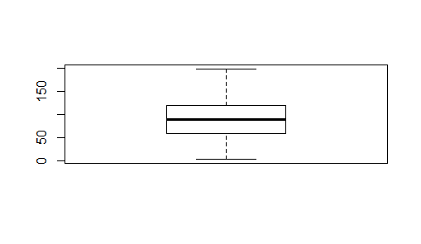
Combined COLUMN

Slide 10
Conditional combination
moody$conditional <-0
moody[moody$PARTICIPATION<0.5, ]$conditional <- moody[moody$PARTICIPATION<0.5, ]$SCORE -10*moody[moody$PARTICIPATION<0.5, ]$PARTICIPATION
moody[moody$PARTICIPATION>=0.5, ]$conditional <- moody[moody$PARTICIPATION>=0.5, ]$SCORE +10*moody[moody$PARTICIPATION>=0.5, ]$PARTICIPATION
boxplot(moody$conditional)

Slide 11
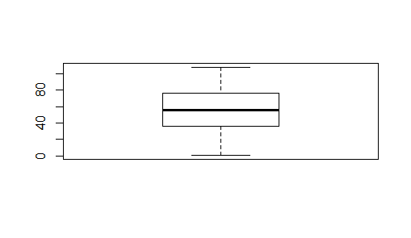

Slide 12
What would R say?
min(moody[moody$GRADE=='A', ]$SCORE)
max(moody[moody$GRADE=='A', ]$SCORE)
min(moody[moody$GRADE=='A', ]$conditional)
max(moody[moody$GRADE=='A', ]$conditional))
moody[moody$conditional > moody$SCORE,c(1,2,8)]

Slide 13
EXPLORATION OF DATA
tapply(moody$SCORE, moody$GRADE, mean)
tapply(moody$SCORE, moody$TEXTING_IN_CLASS, mean)

Slide 14
Exploration of DATA
mean(moody[moody$GRADE=='A' & moody$PARTICIPATION<0.5,]$SCORE)
mean(moody[moody$GRADE=='A' & moody$PARTICIPATION>0.5,]$SCORE)

Slide 15
Questions you should ask
Would texting in class have negative influence on the grade?
How about dozing off?
Participation?
Does score matter?

